Slide 1

Uber Data Engineering Project: Designing and Implementing an ETL Pipeline
Building Scalable ETL Pipelines for Real-Time Analytics on-Prem with Python + Airflow + PostgreSQL+ GCS

Slide 2

Project Overview
Problem: Raw Uber booking data (CSV) needed to be cleaned, transformed, and loaded into BigQuery.
Solution: ETL pipeline using Python scripts orchestrated by Airflow.
Outcomes: Automated data pipeline, dimensional model (facts + dimensions), analytics-ready data.
The pipeline aims to provide timely and accurate data to drive informed decisions, improve operational efficiency, and enhance customer satisfaction. It supports scalability and flexibility to adapt to Uber’s evolving data needs.

Slide 3
ETL Pipeline Architecture and Design

Slide 4
ETL Architecture
Source: Google Drive → Staging in GCS.
Transform: Python cleaning + normalization.
Load: Dimension + Fact tables → GCS outputs + Postgres SQL .
Orchestration: Airflow DAG for scheduling + automation.

Slide 5
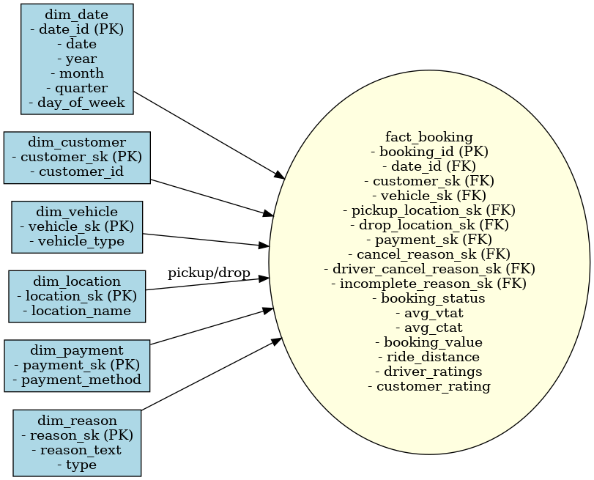
Data Warehouse Star Schema
The warehouse schema was designed in a star schema pattern:
- Fact Table:
fact_uber_trips
- Dimension Tables:
dim_date
dim_customer
dim_vehicle
dim_location
dim_payment
dim_reason
This structure optimizes analytical queries and reporting.
Notes:
--- The architecture includes distributed data storage, scalable compute clusters, and workflow orchestration tools. Technologies leveraged may include Apache Kafka for streaming, Spark for processing, and cloud platforms for storage and scalability. Image source: Microsoft 365 content library

Slide 6
Implementation Details and Challenges
Notes:
Here we explore the specifics of data extraction methods, transformation techniques, and loading mechanisms. We also address common challenges such as data quality, scalability, and performance optimization.

Slide 7
Reads raw Uber CSV from Google Drive.
Uploads file to staging bucket in Azure.
Code Snippet:
from google.cloud import storage
def upload_to_gcs(bucket_name, source_file, destination_blob):
client = storage.Client()
bucket = client.bucket(bucket_name)
blob = bucket.blob(destination_blob)
blob.upload_from_filename(source_file)
print(f'{source_file} uploaded to {destination_blob}')
Data Extraction (extraction.py)
Notes:
--- Extraction involves API integration, log data ingestion, and streaming data capture. Methods are designed to handle high throughput and ensure minimal latency for real-time data availability. Image source: Microsoft 365 content library

Slide 8
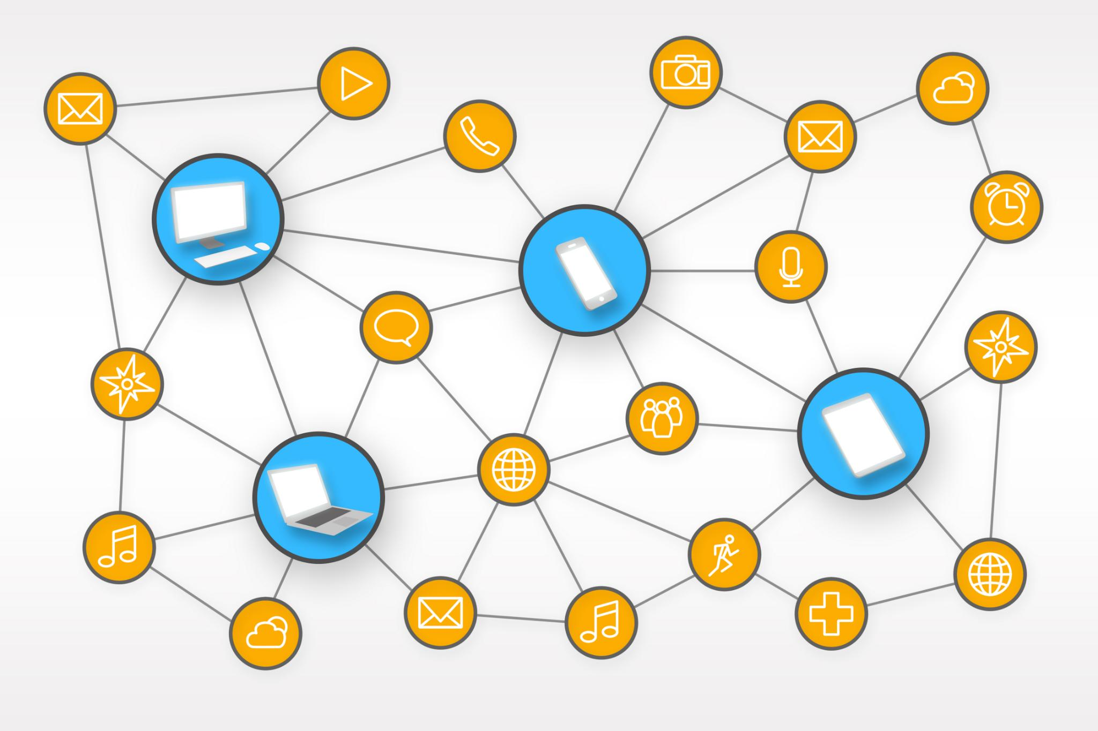
Data Transformation, Cleaning, and Enrichment Techniques (transformation.py)
Data Validation
Ensures data accuracy by checking for errors and inconsistencies before analysis. Standardizes column names., Parses date + time into date_id, Normalizes categorical fields.
Deduplication
Removes duplicate records to maintain data integrity and reduce redundancy.
Normalization
Standardizes data formats to ensure consistency across datasets for better analysis.
Code Snippet:
def standardize_columns(row):
new_row = {k.strip().lower().replace(' ', '_'): v for k, v in row.items()}
return new_row
def parse_datetime(row):
ts = datetime.strptime(f"{row['date']} {row['time']}", "%Y-%m-%d %H:%M:%S")
row['date_id'] = int(ts.strftime('%Y%m%d'))
return row
Notes:
--- Transformations include data validation, deduplication, normalization, and enrichment with external datasets. These steps improve data accuracy and usability for downstream analytics. Image source: Microsoft 365 content library

Slide 9

Loading (loading.py)
Writes cleaned data, facts + dimensions to GCS.
Loads dimensions + fact table into PostgreSQL.
Code Snippet:
from google.cloud import bigquery
def load_to_bq(table_id, rows, schema):
client = bigquery.Client()
errors = client.insert_rows_json(table_id, rows)
if errors:
print('Errors:', errors)
else:
print(f'Loaded {len(rows)} rows into {table_id}')
Notes:
--- Loading uses batch and streaming methods to populate data warehouses and marts. The system is optimized for parallel processing and resource management to support growing data volumes efficiently. Image source: Microsoft 365 content library

Slide 10
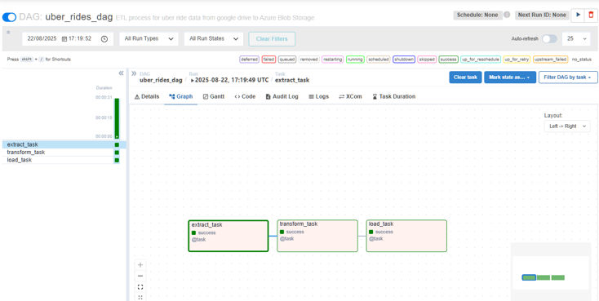
Data Workflow and Orchestration Strategies: Airflow Orchestration (uber_dag.py)
Automates ETL steps.
Defines DAG with dependencies: extract → transform → load.
Runs daily / on-demand.
Code Snippet:
from airflow import DAG
from airflow.operators.python import PythonOperator
with DAG('uber_etl_pipeline', schedule_interval='@daily') as dag:
extract_task = PythonOperator(task_id='extract', python_callable=extract)
transform_task = PythonOperator(task_id='transform', python_callable=transform)
load_task = PythonOperator(task_id='load', python_callable=load)
extract_task >> transform_task >> load_task
Notes:
--- Workflows are managed using orchestration frameworks to automate task execution, handle dependencies, and enable retries on failure. This ensures reliability and efficiency in data processing pipelines. Image source: Microsoft 365 content library

Slide 11
Load to Azure Synapse

Slide 12

Continuous Improvement and Future Enhancements
Pipeline Evaluation and Feedback
Regular pipeline evaluation and feedback incorporation optimize current performance and identify improvement areas.
Automation and Machine Learning
Future enhancements focus on deeper automation and integrating machine learning to improve efficiency and intelligence.
Expanded Data Source Support
Adding support for more diverse data sources will broaden capabilities and enhance analysis.

Slide 13
Conclusion
Scalable Data Infrastructure
The ETL pipeline is built to handle increasing volumes of data efficiently and reliably.
Addressing Data Challenges
The system design tackles critical challenges to maintain smooth and accurate data flow.
Supporting Business Intelligence
Reliable ETL processes enable effective business intelligence and operational decision-making.
Notes:
The Uber ETL pipeline project demonstrates a comprehensive approach to building scalable data infrastructure. Its design and implementation address critical data challenges, ensuring reliable data flow that supports Uber’s business intelligence and operational needs.

